Slide 1
AeroManageX
Aerotech Titans
Bashir Dahir
Nihar Lodaya
Marguerite McGahay

Slide 2
AGENDA
Introduction​
Meet the Team
​Areas of growth
Timeline
​Summary​
1​

Slide 3
Introduction
The primary objective of the AeroManageX project is to elevate your airline’s existing database infrastructure to be able to better compete with the world’s top airlines. Our company will help you condense the mass amount of information needed to be able to have thousands of planes arrive and depart each day. Our system operates to help your airline in multiple ways, including but not limited to managing flight bookings, optimizing the cost of flights, making sure planes are in the necessary airports based on place of departure and arrival, and efficiently assigning pilots to flights that make sense for your company and their schedules.

Slide 4
MEET OUR TEAM
Bashir
Dahir
Nihar
Lodaya
Marguerite McGahay​
I'm a Computer Science student at Marist College, Beacon, New York, in my fifth year, with just two semesters to go before graduation. My academic journey has sharpened my skills in programming and data structures, but my true passion lies in database management systems. Currently, I'm eagerly gearing up for a project focused on airline management systems, where I plan to apply my expertise in database management to create efficient and robust solutions for the aviation industry. Beyond academics, I enjoy problem-solving and community engagement.
Hey there, I'm Nihar Lodaya, and I come from India. I've got a bachelor's degree in computer science from back home, and right now, I'm in the middle of my master's program in Computer Science at Marist College. I'm stoked about working with this bunch of awesome folks on our current project. What really got me excited about my teammates Bashir & Marguerite is how dedicated they are to making this project a success.
I grew up in Poughkeepsie and then attended the University of Delaware, where I graduated in 2021 with a BS in Mathematics and a Minor in Computer Science. While I was there, I was a TA for multiple computer science classes and was also on the Women’s Rowing Team! I currently work at Marist as the Assistant Women’s Rowing Coach. This is my first semester in the Computer Science – Software Development program, so I don’t know many people, but I was excited when Bashir and Nihar extended an invitation for me to be a member of this group

Slide 5
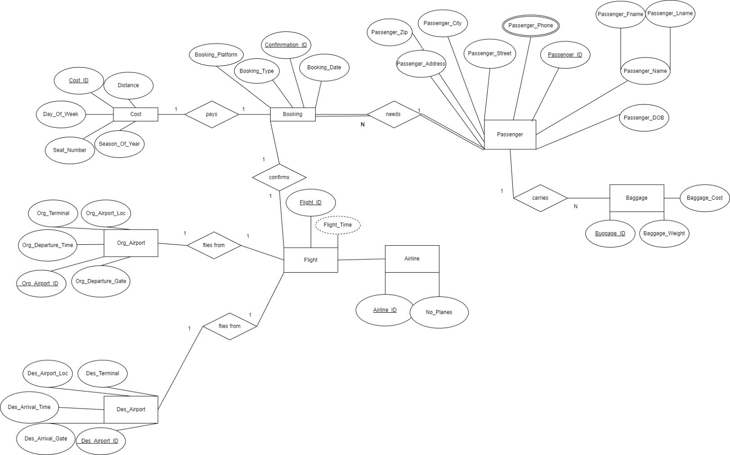
External ER Diagram: Manager Model
Notes:
In the External Entity Relationship Diagram for the Manager Model in our AeroManageX, the primary entities include Flight, Origin Airport, Destination Airport, Pilot, Flight Attendant, Plane, and Airline. Flight is the central entity, while Origin Airport and Destination Airport are directly connected to Flight, representing the departure and arrival locations. Pilots are associated with specific flights as they operate them, and Flight Attendants work on board these flights. The Plane entity represents the aircraft used for the flights, and Airline serves as a parent entity encompassing various flights operated by the airline. This diagram illustrates how these entities are interrelated, providing a clear overview of the airline's operations.

Slide 6
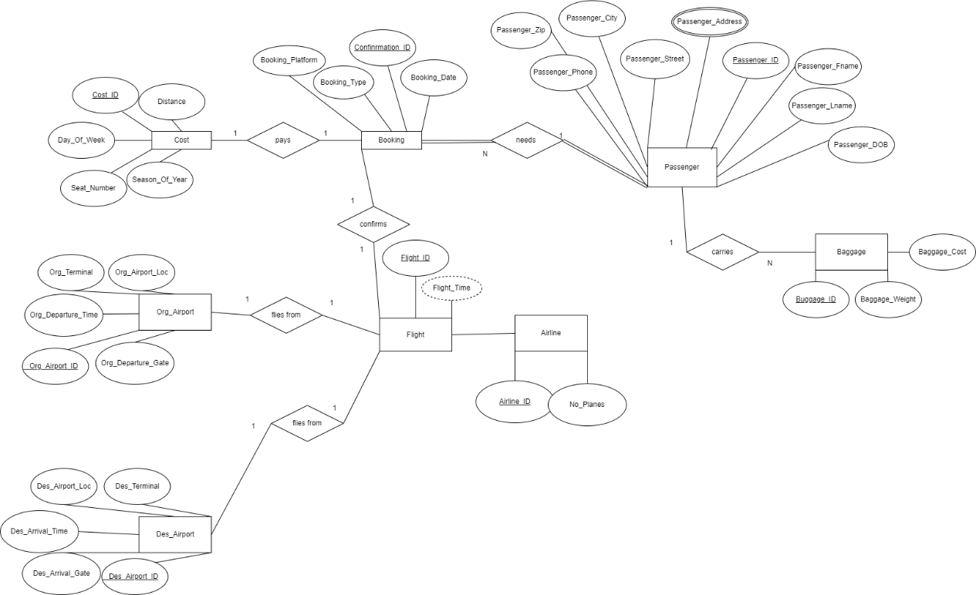
External ER Diagram: Booking Agent Model
Notes:
In the External Entity Relationship Diagram for the Booking Agent Model in the AeroManageX, a web of interconnected entities and relationships emerges. Cost is linked to Booking, reflecting the financial transaction between booking agents and reservations. Booking necessitates Passenger, showing the connection between bookings and the passengers they are made for, while Passenger also carries Baggage, signifying the belongings associated with passengers. Bookings confirm Flights, illustrating the reservation process, and Flights are tied to both Origin and Destination Airports, representing the departure and arrival points of the journeys.

Slide 7
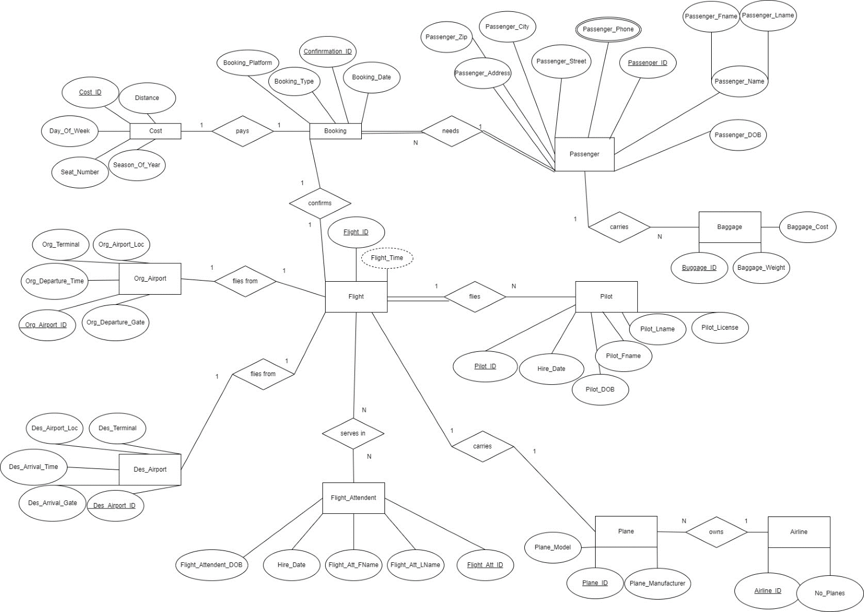
Entity Relationship Diagram
Notes:
Creating this project involves a thoughtful selection of entities, attributes, relationships, participations, and cardinalities to represent a simplified domain. In this case, the chosen entities include "Cost," "Baggage," "Booking," "Plane," "Flight," "Flight_Attendant," "Org_Airport," "Des_Airport," "Pilot," "Passenger," and "Airline." Each of these entities represents key elements in the domain of Airline travel. Attributes are then identified for each entity to capture relevant information; for instance, "Passenger" have attributes like Passenger_Fname, Passenger_Lname, Passenger_Address, etc. Similarly, "Cost" has attributes like Confirmation_ID, Distance, Season_Of_Year, etc. Relationships are established between entities to represent how they are connected, such as the relationship between "Booking" and "Passenger" to show that a passenger can make a booking.

Slide 8
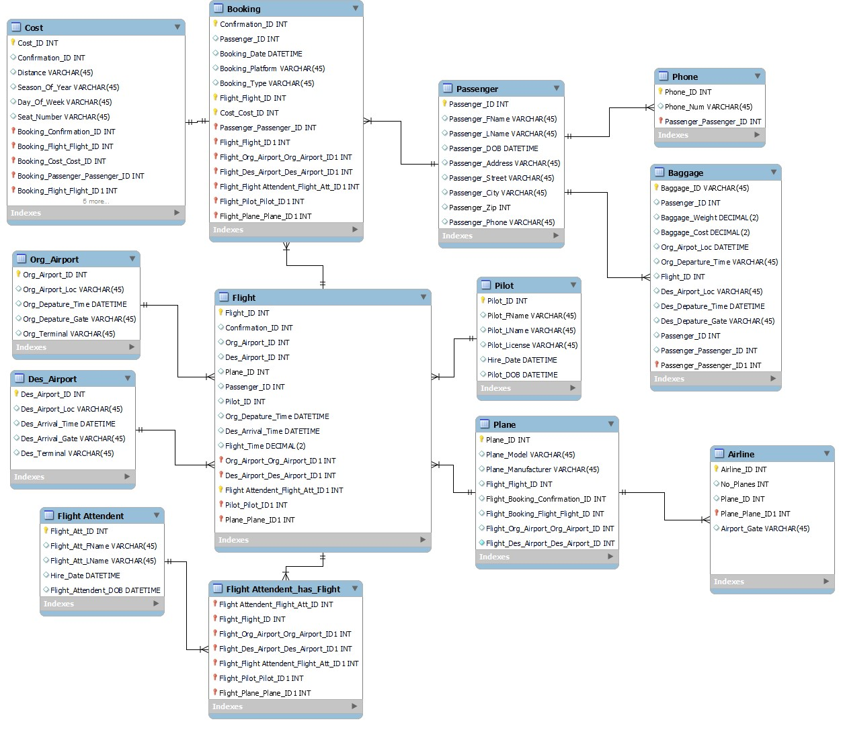
Enhanced entity relationship (EER) Diagram

Slide 9
Attribute | Data Type | Description
Airline_ID | INT | This attribute serves as the primary key for the "Airline" table, uniquely identifying each airline record. It is an integer (INT) data type and is required, meaning it cannot be null.
No_Planes | INT | The "No_Planes" attribute represents the number of planes associated with the airline. It is of integer (INT) data type and is not marked as required (nullable).
Plane_ID | INT | This attribute is used to store the ID of a specific plane associated with the airline. It is of integer (INT) data type and is not marked as required (nullable).
Airport_Gate | VARCHAR | The "Airport_Gate" attribute stores textual information related to the airport gate used by the airline. It is of VARCHAR(45) data type, allowing up to 45 characters, and is not marked as required (nullable).
Num_Employees | INT | This attribute represents the number of employees working for the airline. It is of integer (INT) data type and is required, meaning it cannot be null.
-- Table mydb.Airline
DROP TABLE IF EXISTS mydb.Airline;
CREATE TABLE IF NOT EXISTS mydb.Airline (
Airline_ID INT NOT NULL,
No_Planes INT NULL,
Plane_ID INT NULL,
Airport_Gate VARCHAR(45) NULL,
Num_Employees INT,
PRIMARY KEY (Airline_ID)
);

Slide 10
Now to show you our Implementation

Slide 11
Enhancements
In order to improve this project even more, a few things could be added:
User roles and access levels should be divided into a more comprehensive login system for user authentication and authorization.
Data validation is the process of applying extensive validation checks for user inputs in order to guarantee data confidentiality and accuracy.
Reporting and Analytics: Including a function for creating reports and examining patterns in data.
Including graphical data representations for enhanced comprehension and analysis is known as interactive visualization.
Real-time Updates: To allow for immediate data updates, enable real-time synchronization between the database and the GUI.
Mobile responsiveness: Making the graphical user interface (GUI) more accessible on mobile devices.
The program would become more adaptable, safe, and user-friendly by adding these features, meeting the needs and preferences of a larger spectrum of users.

Slide 12
Conclusion
We learned a lot about database design, application development, and the value of user experience while working on this project. SQL code taught us how to turn abstract ideas into actual structures, from building the Entity-Relationship models to implementing the database in MySQL. Assuring data integrity and improving system efficiency grew dependent on performance optimizations and normalization checks. Creating the graphical user interface (GUI) required careful planning and user-friendly design, which was an exciting challenge. The pages of the GUI, which included the login, main menu, search, insertion, modification, deletion, and data display, were linked together to offer the user smooth functioning and navigation. To demonstrate these views' functionality, links to the database, and the code behind each page's features, we used comprehensive design descriptions, visualizations, and source code in their implementation.

Slide 13
References
Airline Suite. (n.d.). Airline Suite Reviews - Pros & Cons, Ratings & More. GetApp. https://www.getapp.com/operations-management-software/a/airline-suite/reviews/
Aviation Maintenance Operations & Aircraft Management Software: RAMCO systems. Aviation Maintenance Operations & Aircraft Management Software | Ramco Systems. (n.d.). https://www.ramco.com/products/aviation-software/?utm_source=capterra&utm_medium=capterra_ppc&utm_campaign=capterra_aviation&utm_channel=capterra
AvPro. (n.d.-a). Aircraft Maintenance Software: Wellington FL: AvPro software. avpro. https://www.avprosoftware.com/
AvPro. (n.d.). Fly Safer. work smarter. C.A.L.M. Systems | Airline Suite | Aviation Management Software. https://info.gartnerdigitalmarkets.com/calm-systems-gdm-lp?utm_source=capterra
Trustradius. (2021, June 16). Pros and cons of Ramco ERP 2023. TrustRadius. https://www.trustradius.com/products/ramco-erp/reviews?qs=pros-and-cons#reviews

